Slide 1
CSLife
06/22/2026
Members: Marco Nasirpour (Product Owner), Nima Jamshidi, Adrian Lopez, Ethan Zarella, Saniha Sreedhara

Slide 2
The Problem
CS is a rigorous and competitive major with uncertainty in the job market.
Motivation: As CS students ourselves, we’ve struggled to maintain “work-life balance”.
In our application:
Users prioritize coding, study, social life, work, and rest across 4 quarters
Experience life events like hackathons, exams, and car problems
See effects on happiness, health, social life, GPA and more.
See effects on graduation outcomes.
Allows new/future CS students to see if CS is for them.
Gives students and idea on how to maintain work-life balance.

Slide 3
Our Goals
Create a fun and interactive simulator of a Computer Science student’s college experience
Teach players the importance of finding a balance in their academic, social and personal lives
Show how the decisions they make throughout their college, effects their GPA, health, happiness, and future career goals
Test player’s knowledge on actual computer science concepts such as: Data Structures, Computer Principles, Computer Architecture and Programming languages: Python, C, and C++

Slide 4
Biggest Challenges
Requires several mini-games which was time consuming to implement
Requires multiple unique events to keep game engaging
Many screens meant huge focus on design
Managing and updating player data across multiple pages
Had occasional merge conflicts
Time zone differences

Slide 5
Live Demo

Slide 6
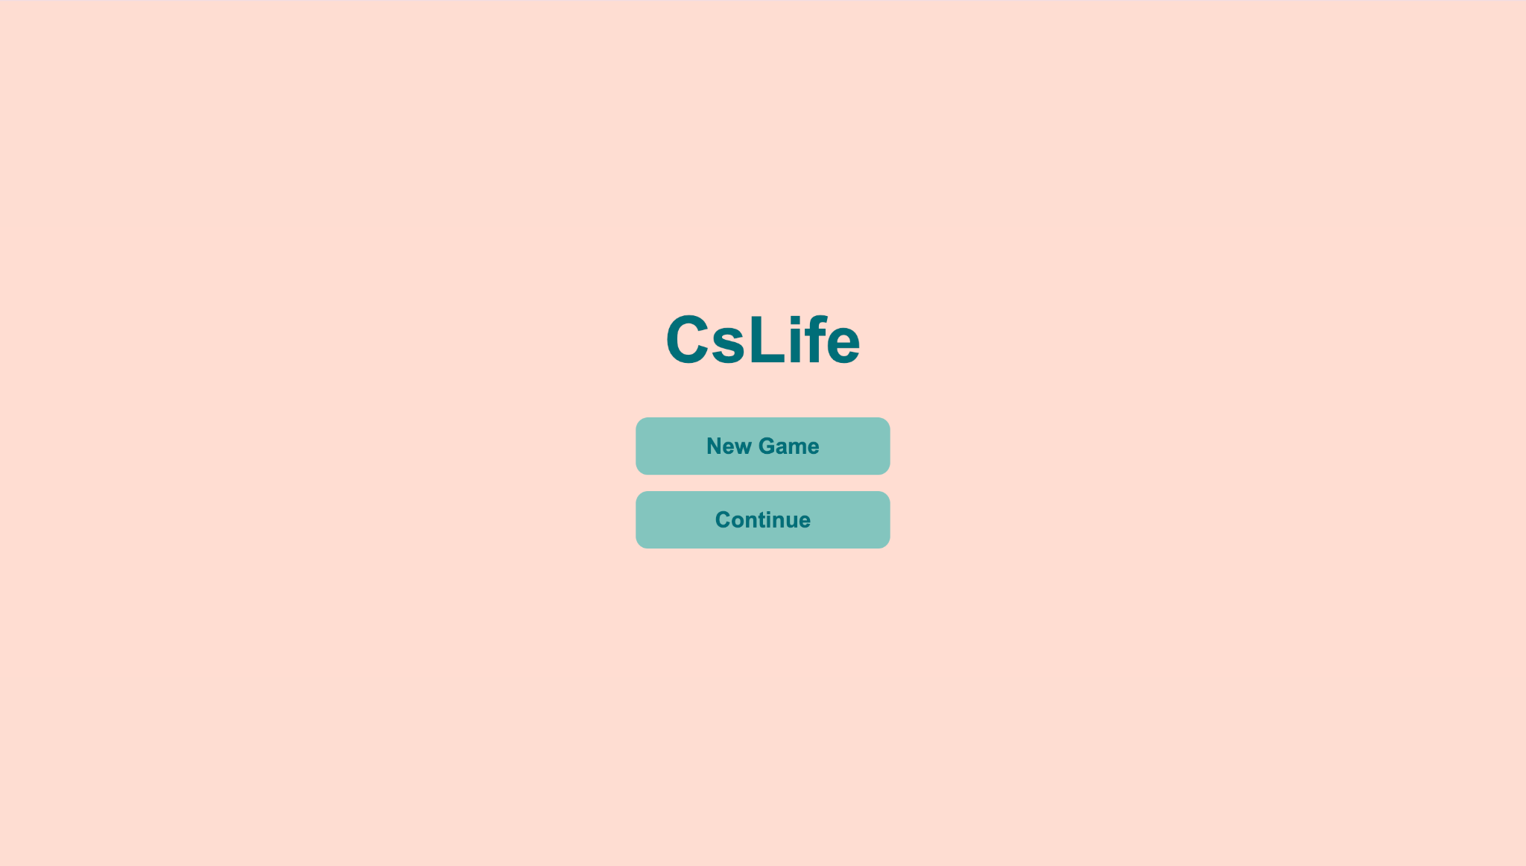
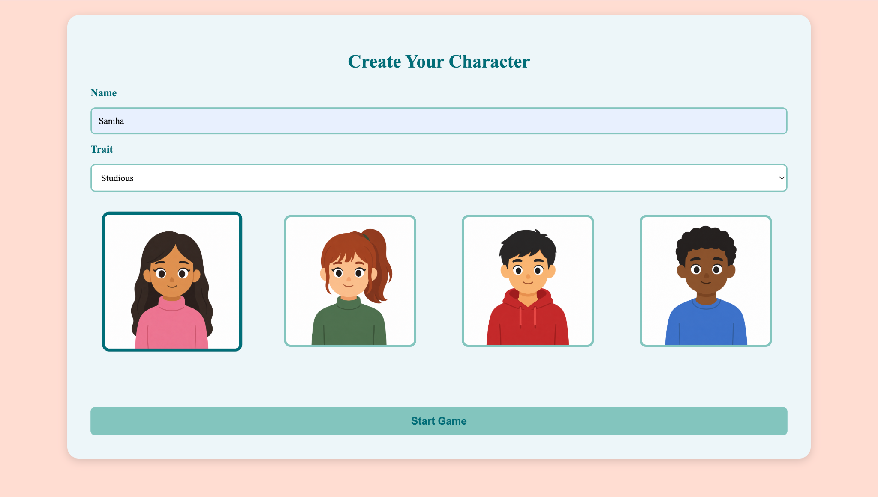
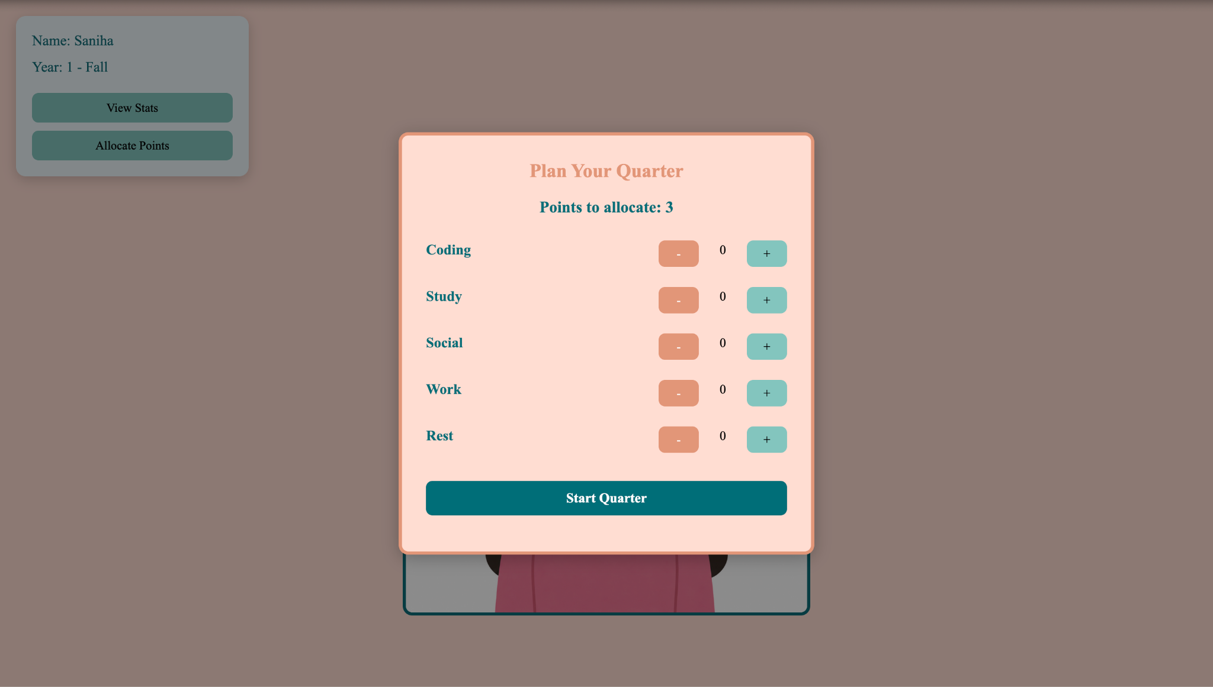
System Overview
Start Menu
Character Creation
Point Allocation

Slide 7
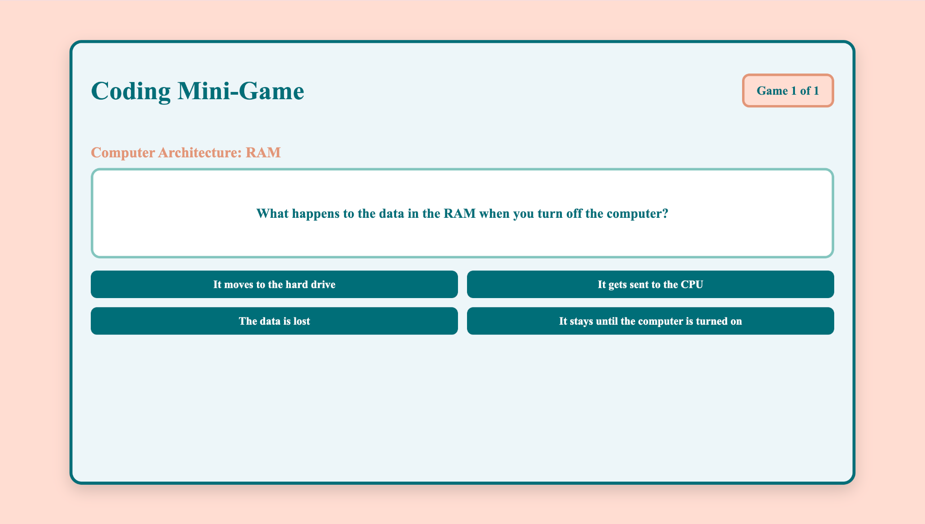
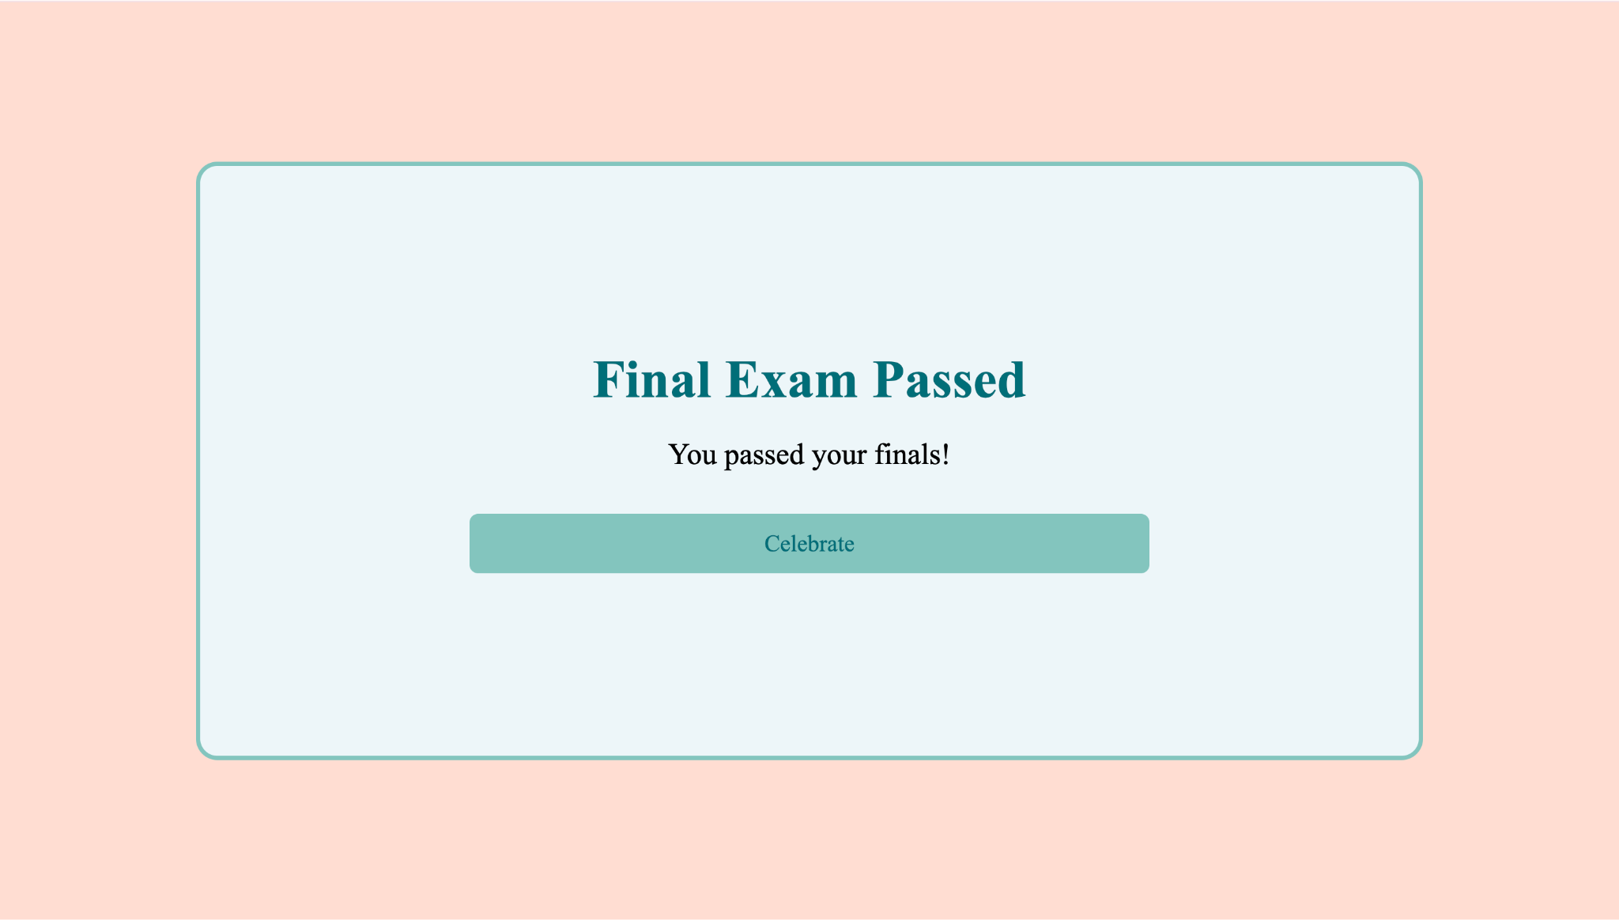
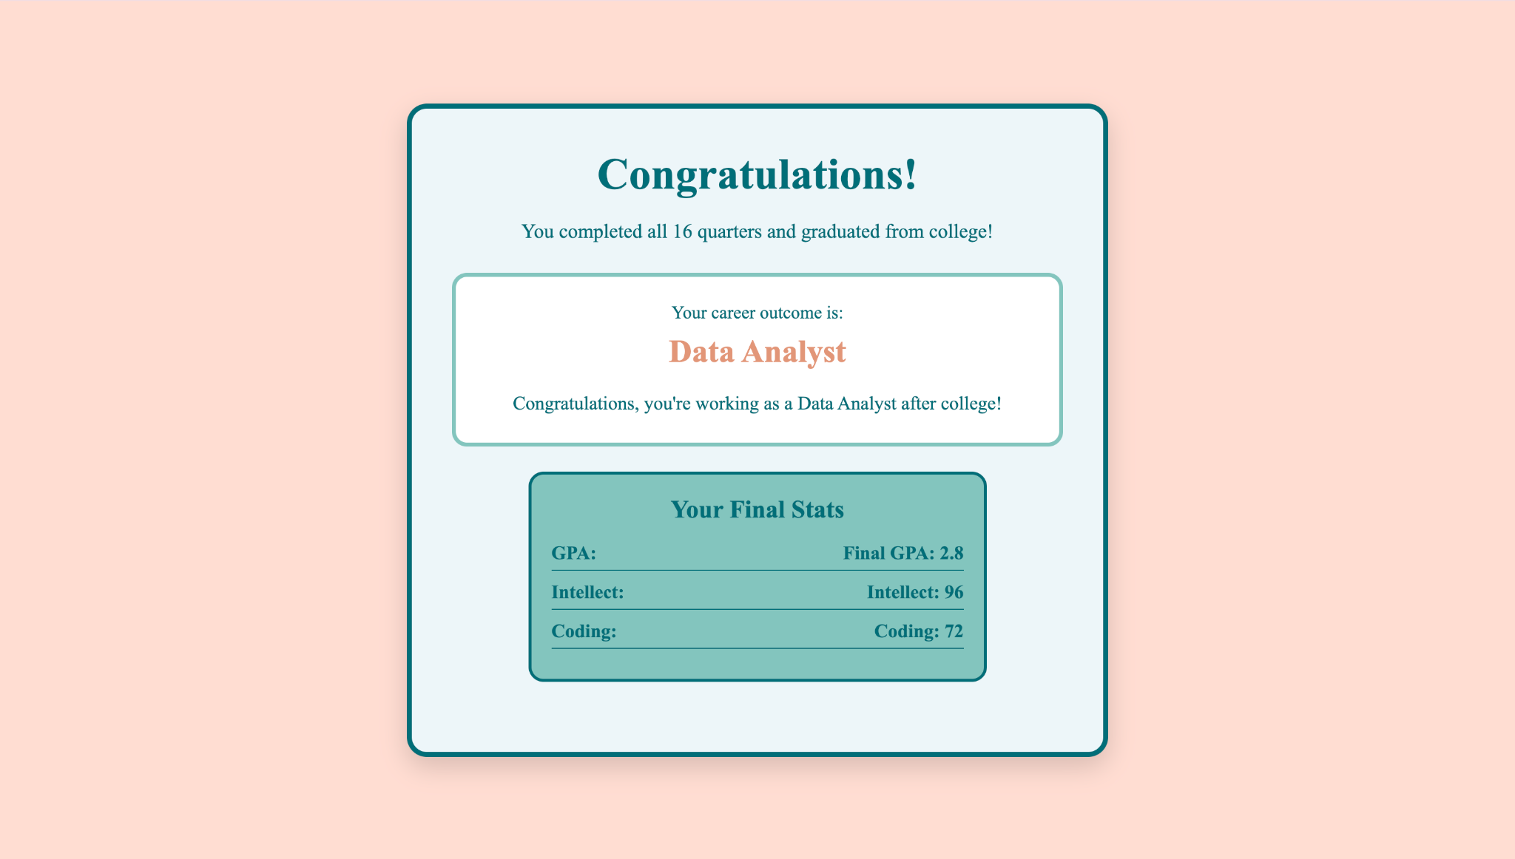
System Overview Cont.
Mini-Games
Random Event
Grad Outcome

Slide 8
Technologies
Github:
Shared repository used by all five members
Github projects was used to manage tasks, user stories, sprint planning and overall project progression
Visual Studio Code (VS Code):
Main environment used to write and edit the codebase
Extension (Live Server): used locally to run and test the game
Browser Local Storage:
Saving player progression and ensuring the game data was saved without needing to use a database

Slide 9
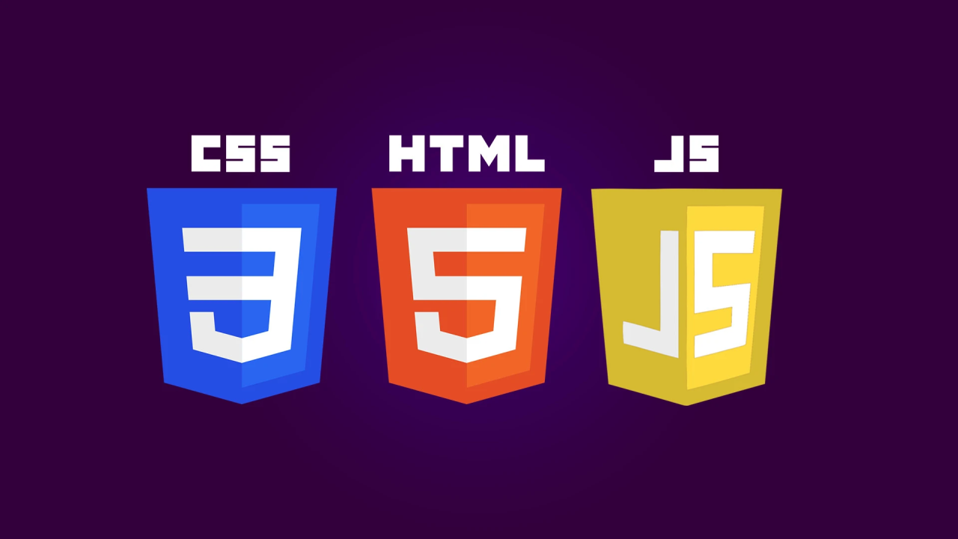
Technologies
Programming Languages:
HTML: Build the structure and layout of the game interface
CSS: Styling the game screen and it’s layouts
JavaScript: Implementing game logic, including mini-games, events, and user interactions

Slide 10
Project Management Techniques
Scrum:
Used Agile Scrum workflow for all four sprints
Held regular meetings to discuss project progress and ensure that everyone is on track
User Stories:
Defined user stories to guide what the features need to look like
Split each user story into multiple smaller and manageable tasks
Sprint Planning:
Planned each sprint before implementing
Assigned user stories and tasks to each team member

Slide 11
Project Management Techniques
Github Projects:
Used Github projects to organize tasks and track sprint progress
Organize tasks into different sections (To Do, In Progress, Testing, Review with Group, and Done) to keep track of status of each task
Team communication:
Communicated through group text messages and regular meetings
Resolved issues and conflicts by coordinating in the meetings

Slide 12
What We Liked/Disliked
Liked:
Use of the project board on Github
Frequent meetings
Regular updates
Adding fun features like the avatar
Game is easy to understand and play
Multiple possible endings promotes users to replay
Disliked:
Confusion in sprint schedule
Occasional merge conflicts
Could implement more graduation outcomes

Slide 13
Lessons Learned
Teamwork and Collaboration:
Practiced and further developed engineering practices learned during the course
continuous integration, peer review…
Basic Scrum Methodology
Learned basic project management practices
Scrum teams, sprint planning, Daily Scrum
Team Programming Practices
Learned team programming practice
Working one file at a time, coding functions with only one responsibility and fixing GitHub conflicts

Slide 14
Thank You!
Questions/Comments?

